Slide 1
Macros in c

Slide 2

Macros
The C preprocessor is a macro pre-processor (allows you to define macros) that transforms your program before it is compiled. These transformations can be inclusion of header file, macro expansions etc.
All preprocessor commands begin with a hash symbol #

Slide 3
Macro Syntax
Example :1
#define MAX_ARRAY_LENGTH 20

Slide 4
Macros _ Example
Example :2
#include <stdio.h>
#define PI 3.1415
int main()
{
float radius, area;
printf("Enter the radius: ");
scanf("%d", &radius);
// Notice, the use of PI
area = PI*radius*radius;
printf("Area=%.2f",area);
return 0;
}

Slide 5
Predefined Macros
1 | __DATE__ The current date as a character literal in "MMM DD YYYY" format.
2 | __TIME__ The current time as a character literal in "HH:MM:SS" format.
3 | __FILE__ This contains the current filename as a string literal.
4 | __LINE__ This contains the current line number as a decimal constant.

Slide 6
Predefined Macros - Example
#include <stdio.h>
main() {
printf("File :%s\n", __FILE__ );
printf("Date :%s\n", __DATE__ );
printf("Time :%s\n", __TIME__ );
printf("Line :%d\n", __LINE__ );
}

Slide 7
Object-like Macros
#define C 1000
#define PI 3.14
#define BUFSIZE 1020

Slide 8
Object-like Macros (contd…,)
#include <stdio.h>
#define START int main(){
#define STOP }
START
printf("Hello");
STOP

Slide 9

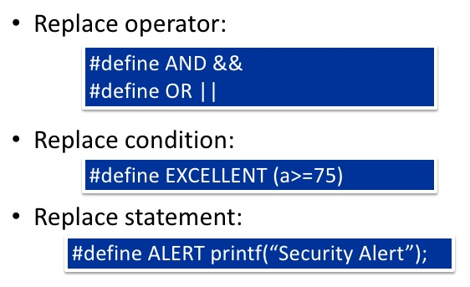

Slide 10
Function-like Macros
#define message()\
printf("Good Morning\n")

Slide 11
Parameterized Macros
#include <stdio.h>
#define PI 3.1415
#define circleArea(r) (PI*r*r)
int main()
{
int radius;
float area;
printf("Enter the radius: ");
scanf("%d", &radius);
area = circleArea(radius);
printf("Area = %.2f", area);
return 0;
}
#include <stdio.h>
#define MAX(x,y) ((x) > (y) ? (x) : (y))
int main(void) {
printf("Max between 20 and 10 is %d\n", MAX(10, 20));
return 0;
}

Slide 12
Conditional Compilation
#ifdef MACRONAME
Statement_block;
#endif
#include<stdio.h>
#define NUM 10
#ifdef NUM
#define MAX 20
#endif
void main()
{
printf("MAX number is : %d",MAX);
}
#include<stdio.h>
int main(){
#ifdef __DATE__
printf("%s",__DATE__);
#else
printf("__DATE__ is not defined");
#endif
return 0;
}
#if defined BUFSIZE && BUFSIZE >= 1024

Slide 13
Sr.No. | Directive | Description
1 | #define | Substitutes a preprocessor macro.
2 | #include | Inserts a particular header from another file.
3 | #undef | Undefines a preprocessor macro.
4 | #ifdef | Returns true if this macro is defined.
5 | #ifndef | Returns true if this macro is not defined.
6 | #if | Tests if a compile time condition is true.
7 | #else | The alternative for #if.
8 | #elif | #else and #if in one statement.
9 | #endif | Ends preprocessor conditional.
10 | #error | Prints error message on stderr.

Slide 14
The Stringize (#) Operator
#include <stdio.h>
#define message_for(a, b)\
printf(#a " and" #b ": You are welcome to PS&OOP!\n");
int main(void) {
message_for(SADRIKA , BHAVISHYA);
return 0;
}

